Slide 1
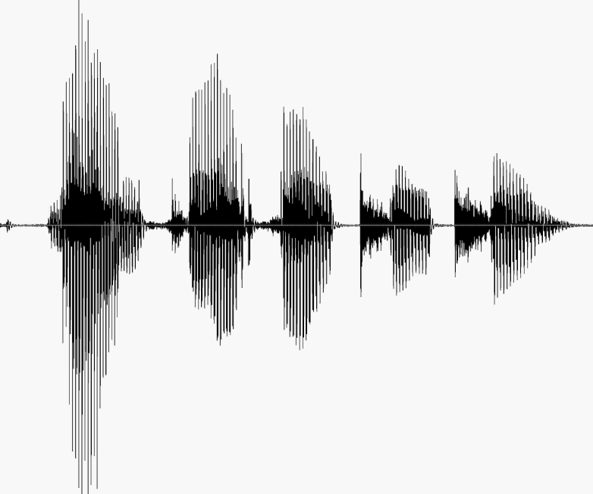
CS 224S / LINGUIST 285 Spoken Language Processing
Andrew Maas
Stanford University
Spring 2017
Lecture 15: Waveform Synthesis in TTS
Original slides by Dan Jurafsky, Alan Black, & Richard Sproat

Slide 2
Predicting Intonation in TTS
Prominence/Accent: Decide which words are accented, which syllable has accent, what sort of accent
Boundaries: Decide where intonational boundaries are
Duration: Specify length of each segment
F0: Generate F0 contour from these

Slide 3
ToBI: Tones and Break Indices
Pitch accent tones
H* “peak accent”
L* “low accent”
L+H* “rising peak accent” (contrastive)
L*+H ‘scooped accent’
H+!H* downstepped high
Boundary tones
L-L% (final low; Am English Declarative contour)
L-H% (continuation rise)
H-H% (yes-no question)
Break indices
0: clitics, 1, word boundaries, 2 short pause
3 intermediate intonation phrase
4 full intonation phrase/final boundary

Slide 4
ToBI example

Slide 5
ToBI example

Slide 6


Examples of the TOBI system
I don’t eat beef.
L* L* L*L-L%
Marianna made the marmalade.
H* L-L%
L* H-H%
“I” means insert.
H* H* H*L-L%
1
H*L- H*L-L%
3
Slide from Lavoie and Podesva

Slide 7
ToBI
http://www.ling.ohio-state.edu/~tobi/
TOBI for American English
http://www.ling.ohio-state.edu/~tobi/ame_tobi/
Silverman, K., Beckman, M., Pitrelli, J., Ostendorf, M., Wightman, C., Price, P., Pierrehumbert, J., and Hirschberg, J. (1992). ToBI: a standard for labelling English prosody. In Proceedings of ICSLP92, volume 2, pages 867-870
Pitrelli, J. F., Beckman, M. E., and Hirschberg, J. (1994). Evaluation of prosodic transcription labeling reliability in the ToBI framework. In ICSLP94, volume 1, pages 123-126
Pierrehumbert, J., and J. Hirschberg (1990) The meaning of intonation contours in the interpretation of discourse. In P. R. Cohen, J.Morgan, and M. E. Pollack, eds., Plans and Intentions inCommunication and Discourse, 271-311. MIT Press.
Beckman and Elam. Guidelines for ToBI Labelling. Web.

Slide 8
F0 Generation
By rule
By linear regression
Some constraints
By accents and boundaries
F0 declines gradually over an utterance (“declination”)

Slide 9
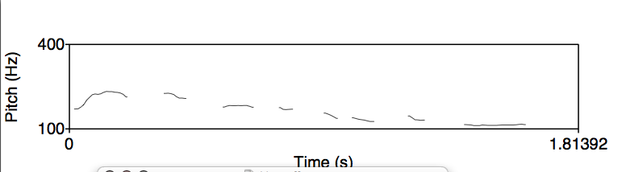
Declination
F0 tends to decline throughout a sentence

Slide 10
F0 Generation by rule
Generate a list of target F0 points for each syllable
For example:
Generate simple H* “hat” accent (fixed speaker-specific F0 values) with 3 pitch points: [110, 140, 100]
Modified by
gender,
declination,
end of sentence,
etc.

Slide 11
F0 generation by regression
Supervised machine learning
We predict: value of F0 at 3 places in each syllable
Predictor features:
Accent of current word, next word, previous
Boundaries
Syllable type, phonetic information
Stress information
Need training sets with pitch accents labeled
F0 is generally defined relative to pitch range
Range between baseline and topline frequency in an utterance

Slide 12
Euclidean distance for F0
Pure Euclidean distance not necessarily a good objective function for F0
Perception maps more to “shape types” of the F0 curve than precise pitch values
(See whiteboard example)

Slide 13
Output of festival generator

Slide 14
Output of festival

Slide 15
Part II: Waveform Synthesis
Given:
String of phones
Prosody
Desired F0 for entire utterance
Duration for each phone
Stress value for each phone, possibly accent value
Generate:
Waveforms

Slide 16

The two stages of TTS
PG&E will file schedules on April 20.
1. Text Analysis: Text into intermediate representation:
2. Waveform Synthesis: From the intermediate representation into waveform

Slide 17
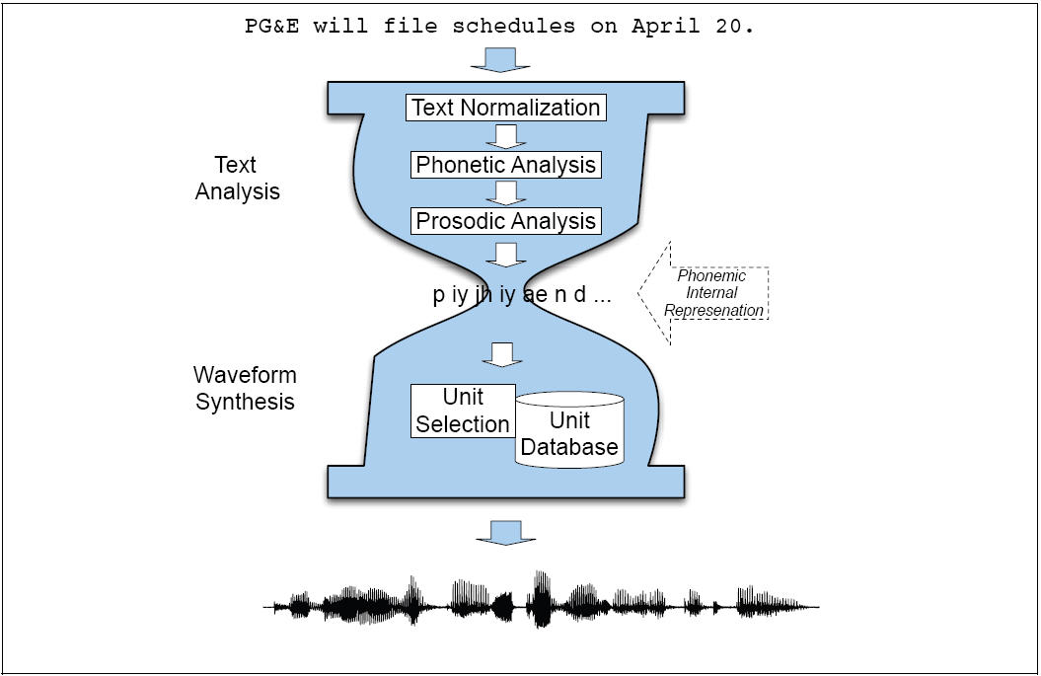

Slide 18
Outline: Waveform Synthesis in TTS
Diphone Synthesis
Unit Selection Synthesis
Target cost
Unit cost
Joining
Dumb
PSOLA
HMM Synthesis

Slide 19
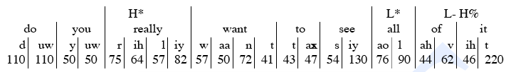
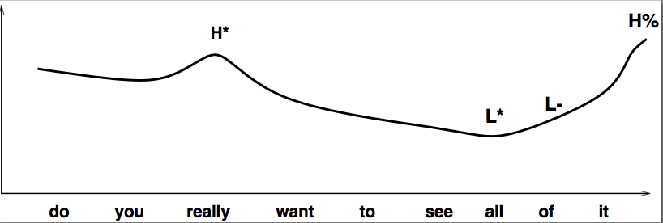
Internal Representation: Input to Waveform Synthesis

Slide 20
Diphone TTS architecture
Training:
Choose units (kinds of diphones)
Record 1 speaker saying 1 example of each diphone
Mark the boundaries of each diphones,
cut each diphone out and create a diphone database
Synthesizing an utterance,
grab relevant sequence of diphones from database
Concatenate the diphones, doing slight signal processing at boundaries
use signal processing to change the prosody (F0, energy, duration) of diphone sequence

Slide 21
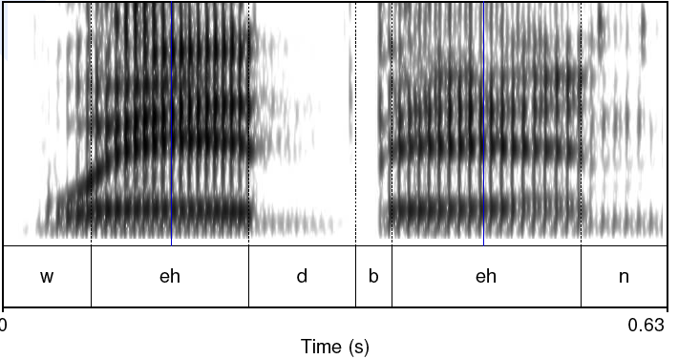
Diphones
Mid-phone is more stable than edge:

Slide 22
Diphones
mid-phone is more stable than edge
Need ~|phones|² number of units
Some combinations don’t exist (hopefully)
ATT (Olive et al. 1998) system had 43 phones
1849 possible diphones
Phonotactics ([h] only occurs before vowels), don’t need to keep diphones across silence
Only 1172 actual diphones
May include stress, consonant clusters
So could have more
Lots of phonetic knowledge in design
Database relatively small (by today’s standards)
Around 8 megabytes for English (16 KHz 16 bit)
Slide from Richard Sproat

Slide 23
Voice
Human speaker
Called a voice talent
Diphone database
Called a voice

Slide 24
Designing a diphone inventory: Nonsense words
Build set of carrier words:
pau t aa b aa b aa pau
pau t aa m aa m aa pau
pau t aa m iy m aa pau
pau t aa m iy m aa pau
pau t aa m ih m aa pau
Advantages:
Easy to get all diphones
Likely to be pronounced consistently
No lexical interference
Disadvantages:
(possibly) bigger database
Speaker becomes bored
Slide from Richard Sproat

Slide 25
Designing a diphone inventory: Natural words
Greedily select sentences/words:
Quebecois arguments
Brouhaha abstractions
Arkansas arranging
Advantages:
Will be pronounced naturally
Easier for speaker to pronounce
Smaller database? (505 pairs vs. 1345 words)
Disadvantages:
May not be pronounced correctly
Slide from Richard Sproat

Slide 26
Making recordings consistent:
Diphone should come from mid-word
Help ensure full articulation
Performed consistently
Constant pitch (monotone), power, duration
Use (synthesized) prompts:
Helps avoid pronunciation problems
Keeps speaker consistent
Used for alignment in labeling
Slide from Richard Sproat

Slide 27
Building diphone schemata
Find list of phones in language:
Plus interesting allophones
Stress, tons, clusters, onset/coda, etc
Foreign (rare) phones.
Build carriers for:
Consonant-vowel, vowel-consonant
Vowel-vowel, consonant-consonant
Silence-phone, phone-silence
Other special cases
Check the output:
List all diphones and justify missing ones
Every diphone list has mistakes
Slide from Richard Sproat

Slide 28
Recording conditions
Ideal:
Anechoic chamber
Studio quality recording
EGG signal
More likely:
Quiet room
Cheap microphone/sound blaster
No EGG
Headmounted microphone
What we can do:
Repeatable conditions
Careful setting on audio levels
Slide from Richard Sproat

Slide 29
Labeling Diphones
Run a speech recognizer in forced alignment mode
Forced alignment:
Given: A trained ASR system, a wavfile, a transcriptions
Returns: an alignment of the phones to the wavfile
Much easier than phonetic labeling:
Words and phone sequence are defined
They are clearly articulated
But sometimes speaker still pronounces wrong, so need to check.
Phone boundaries less important
+- 10 ms is okay
Midphone boundaries important
Where is the stable part
Can it be automatically found?
Slide from Richard Sproat

Slide 30
Diphone auto-alignment
Given
synthesized prompts
Human speech of same prompts
Do a dynamic time warping alignment of the two
Using Euclidean distance
Works very well 95%+
Errors are typically large (easy to fix)
Maybe even automatically detected
Malfrere and Dutoit (1997)
Slide from Richard Sproat

Slide 31
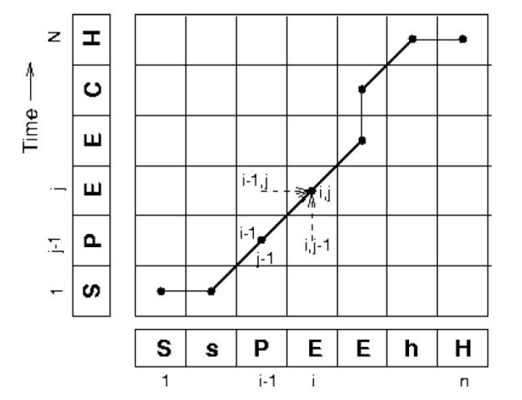
Dynamic Time Warping
Slide from Richard Sproat

Slide 32
Finding diphone boundaries
Stable part in phones
For stops: 33% in
For phone-silence: 25% in
For other diphones: 50% in
In time alignment case:
Given known diphone boundaries in prompt in label file
Use DTW to find same stable point in new speech
Optimal coupling
Taylor and Isard 1991, Conkie and Isard 1996
Instead of precutting the diphones
Wait until we are about to concatenate the diphones together
Then take the 2 complete (uncut diphones)
Find optimal join points by measuring cepstral distance at potential join points, pick best
Slide modified from Richard Sproat

Slide 33
Concatenating diphones: junctures
If waveforms are very different, will perceive a click at the junctures
So need to window them
Also if both diphones are voiced
Need to join them pitch-synchronously
That means we need to know where each pitch period begins, so we can paste at the same place in each pitch period.
Pitch marking or epoch detection: mark where each pitch pulse or epoch occurs
Finding the Instant of Glottal Closure (IGC)
(note difference from pitch tracking)

Slide 34
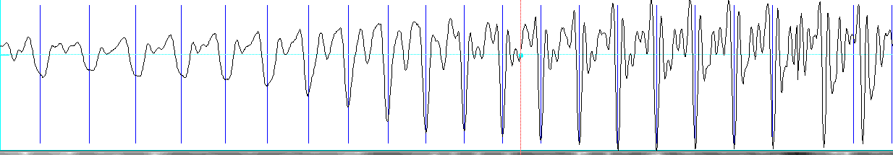
Epoch-labeling
An example of epoch-labeling useing “SHOW PULSES” in Praat:

Slide 35
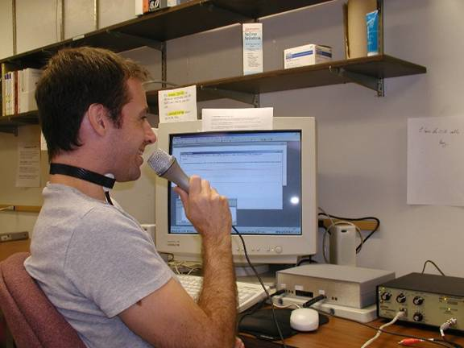
Epoch-labeling: Electroglottograph (EGG) = laryngograph, Lx
Straps on speaker’s neck near larynx
Sends small high frequency current through adam’s apple
Human tissue conducts well; air not as well
Transducer detects how open the glottis is (I.e. amount of air between folds) by measuring impedence.
Picture from UCLA Phonetics Lab

Slide 36
Less invasive way to do epoch-labeling
Signal processing
E.g.:
BROOKES, D. M., AND LOKE, H. P. 1999. Modelling energy flow in the vocal tract with applications to glottal closure and opening detection. In ICASSP 1999.

Slide 37
Prosodic Modification
Modifying pitch and duration independently
Changing sample rate modifies both:
Chipmunk speech
Duration: duplicate/remove parts of the signal
Pitch: resample to change pitch
Text from Alan Black

Slide 38
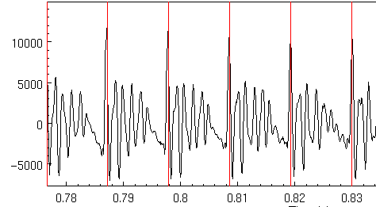
Speech as Short Term signals
Alan Black

Slide 39
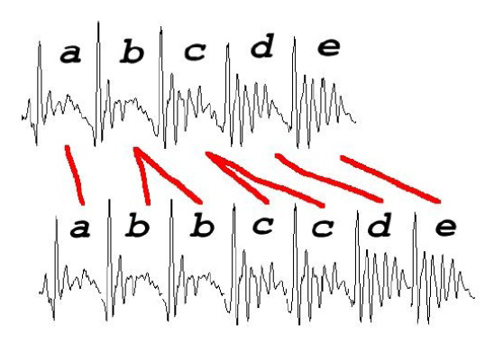
Duration modification
Duplicate/remove short term signals
Slide from Richard Sproat

Slide 40
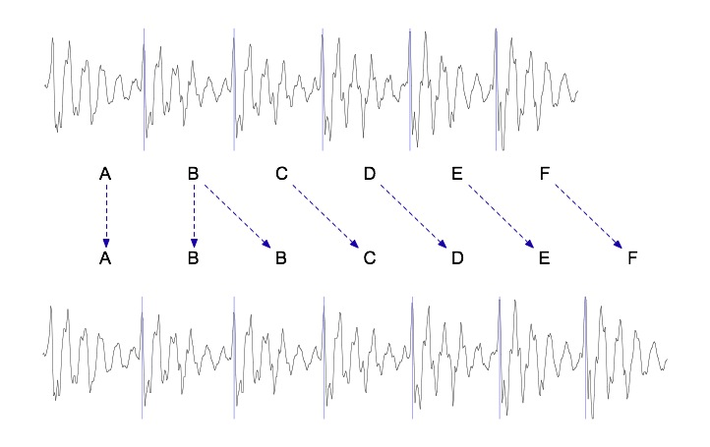
Duration modification
Duplicate/remove short term signals

Slide 41
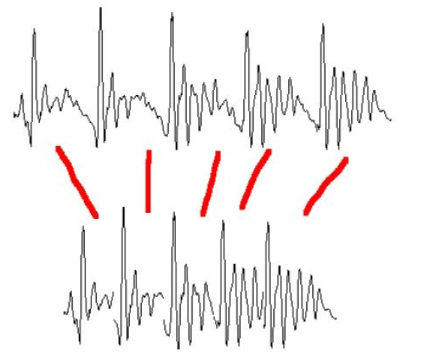
Pitch Modification
Move short-term signals closer together/further apart
Slide from Richard Sproat

Slide 42
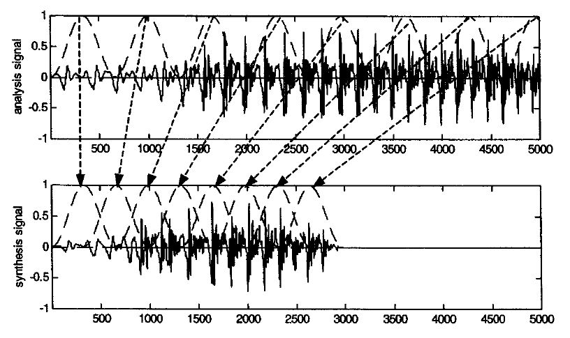
Overlap-and-add (OLA)
Huang, Acero and Hon

Slide 43
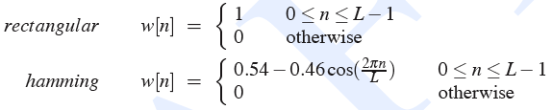
Windowing
Multiply value of signal at sample number n by the value of a windowing function
y[n] = w[n]s[n]

Slide 44
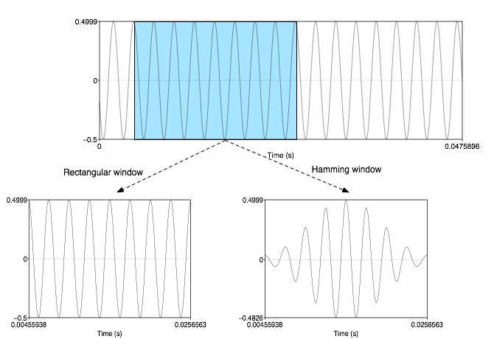
Windowing
y[n] = w[n]s[n]

Slide 45
Overlap and Add (OLA)
Hanning windows of length 2N used to multiply the analysis signal
Resulting windowed signals are added
Analysis windows, spaced 2N
Synthesis windows, spaced N
Time compression is uniform with factor of 2
Pitch periodicity somewhat lost around 4th window
Huang, Acero, and Hon

Slide 46
TD-PSOLA ™
Time-Domain Pitch Synchronous Overlap and Add
Patented by France Telecom (CNET)
Expired in 2004
Very efficient
No FFT (or inverse FFT) required
Can modify Hz up to two times or by half
Slide from Alan Black

Slide 47
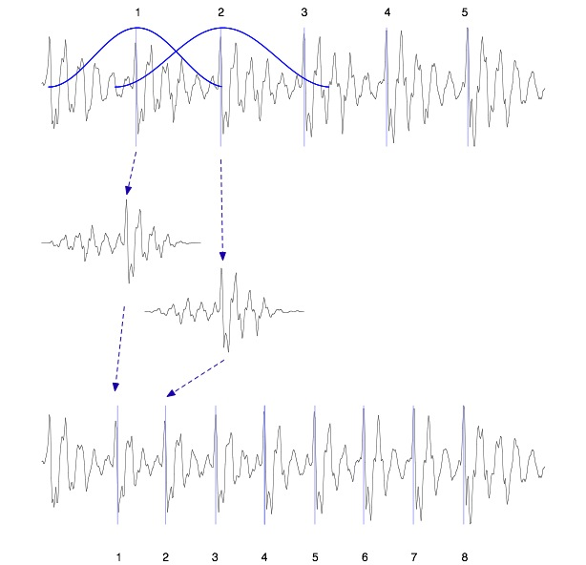
TD-PSOLA ™
Windowed
Pitch-synchronous
Overlap-
-and-add

Slide 48
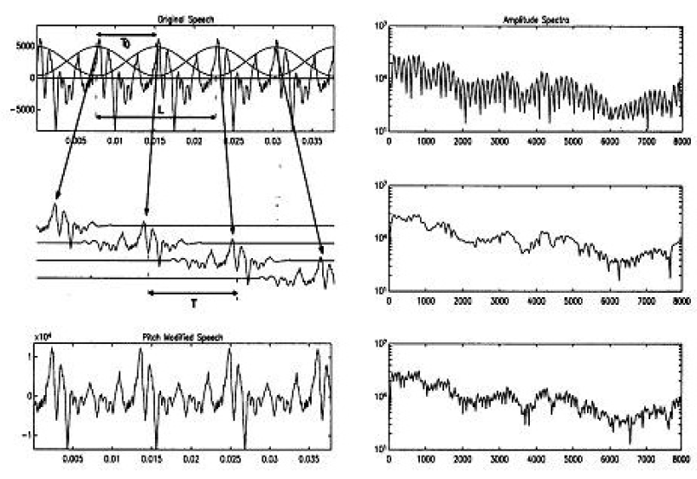
TD-PSOLA ™
Thierry Dutoit

Slide 49
Summary: Diphone Synthesis
Well-understood, mature technology
Augmentations
Stress
Onset/coda
Demi-syllables
Problems:
Signal processing still necessary for modifying durations
Source data is still not natural
Units are just not large enough; can’t handle word-specific effects, etc

Slide 50
Problems with diphone synthesis
Signal processing methods like TD-PSOLA leave artifacts, making the speech sound unnatural
Diphone synthesis only captures local effects
But there are many more global effects (syllable structure, stress pattern, word-level effects)

Slide 51
Unit Selection Synthesis
Generalization of the diphone intuition
Larger units
From diphones to sentences
Many many copies of each unit
10 hours of speech instead of 1500 diphones (a few minutes of speech)
Little or no signal processing applied to each unit
Unlike diphones

Slide 52
Why Unit Selection Synthesis
Natural data solves problems with diphones
Diphone databases are carefully designed but:
Speaker makes errors
Speaker doesn’t speak intended dialect
Require database design to be right
If it’s automatic
Labeled with what the speaker actually said
Coarticulation, schwas, flaps are natural
“There’s no data like more data”
Lots of copies of each unit mean you can choose just the right one for the context
Larger units mean you can capture wider effects

Slide 53
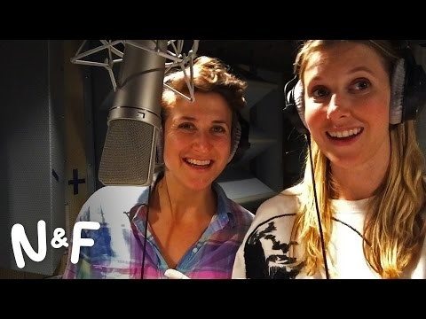
Recording for Google Assistant
Notes:
https://www.youtube.com/watch?v=qnGNfz7JiZ8

Slide 54
Unit Selection Intuition
Given a big database
For each segment (diphone) that we want to synthesize
Find the unit in the database that is the best to synthesize this target segment

Slide 55
Unit Selection Intuition
What does “best” unit mean?
Target cost: Closest match to the target description, in terms of
Phonetic context
F0, stress, phrase position
Join cost: Best join with neighboring units
Matching formants + other spectral characteristics
Matching energy
Matching F0

Slide 56
Targets and Target Costs
A measure of how well a particular unit in the database matches the internal representation produced by the prior stages
Features, costs, and weights
Examples:
/ih-t/ from stressed syllable, phrase internal, high F0, content word
/n-t/ from unstressed syllable, phrase final, low F0, content word
/dh-ax/ from unstressed syllable, phrase initial, high F0, from function word “the”
Slide from Paul Taylor

Slide 57
Target Costs
Comprised of k subcosts
Stress
Phrase position
F0
Phone duration
Lexical identity
Target cost for a unit:
Slide from Paul Taylor

Slide 58
How to set target cost weights (1)
What you really want as a target cost is the perceivable acoustic difference between two units
But we can’t use this, since the target is not acoustic yet, we haven’t synthesized it!
We have to use features that we get from the TTS upper levels (phones, prosody)
But we do have lots of acoustic units in the database.
We could use the acoustic distance between these to help set the weights on the acoustic features.

Slide 59
How to set target cost weights (2)
Clever Hunt and Black (1996) idea:
Hold out some utterances from the database
Now synthesize one of these utterances
Compute all the phonetic, prosodic, duration features
Now for a given unit in the output
For each possible unit that we COULD have used in its place
We can compute its acoustic distance from the TRUE ACTUAL HUMAN utterance.
This acoustic distance can tell us how to weight the phonetic/prosodic/duration features

Slide 60
Join (Concatenation) Cost
Measure of smoothness of join
Measured between two database units (target is irrelevant)
Features, costs, and weights
Comprised of k subcosts:
Spectral features
F0
Energy
Join cost:
Slide from Paul Taylor

Slide 61
Join costs
Hunt and Black 1996
If u_{i-1}== prev(u_{i})
cc=0
Used
MFCC (mel cepstral features)
Local F0
Local absolute power
Hand tuned weights

Slide 62
Join costs
The join cost can be used for more than just part of search
Can use the join cost for optimal coupling (Isard and Taylor 1991, Conkie 1996), i.e., finding the best place to join the two units.
Vary edges within a small amount to find best place for join
This allows different joins with different units
Thus labeling of database (or diphones) need not be so accurate

Slide 63
Total Costs
Hunt and Black 1996
We now have weights (per phone type) for features set between target and database units
Find best path of units through database that minimize:
Standard problem solvable with Viterbi search with beam width constraint for pruning
Slide from Paul Taylor

Slide 64
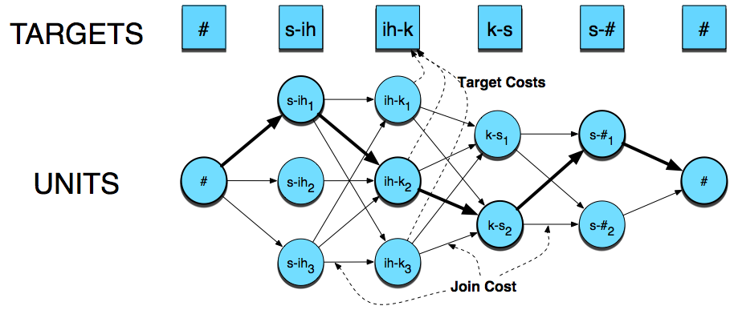
Unit Selection Search

Slide 65
Database creation (1)
Good speaker
Professional speakers are always better:
Consistent style and articulation
Ideally (according to AT&T experiments):
Record 20 professional speakers (small amounts of data)
Build simple synthesis examples
Get many (200?) people to listen and score them
Take best voices
Correlates for human preferences:
High power in unvoiced speech
High power in higher frequencies
Larger pitch range
Text from Paul Taylor and Richard Sproat

Slide 66
Database creation (2)
Good recording conditions
Good script
Application dependent helps
Good word coverage
News data synthesizes as news data
News data is bad for dialog.
Good phonetic coverage, especially wrt context
Low ambiguity
Easy to read
Annotate at phone level, with stress, word information, phrase breaks
Text from Paul Taylor and Richard Sproat

Slide 67
Creating database
Unlike diphones, prosodic variation is a good thing
Accurate annotation is crucial
Pitch annotation needs to be very very accurate
Phone alignments can be done automatically, as described for diphones

Slide 68
Practical System Issues
Size of typical system:
~300M
Speed:
For each diphone, average of 1000 units to choose from, so:
1000 target costs
1000x1000 join costs
Each join cost, say 30x30 float point calculations
10-15 diphones per second
10 billion floating point calculations per second
But commercial systems must run ~50x faster than real time
Heavy pruning essential: 1000 units -> 25 units
Slide from Paul Taylor

Slide 69
Unit Selection Summary
Advantages
Quality is far superior to diphones
Natural prosody selection sounds better
Disadvantages:
Quality can be very bad in places
HCI problem: mix of very good and very bad is quite annoying
Synthesis is computationally expensive
Can’t synthesize everything you want:
Unit seleciton (unlike diphone synth) can’t move emphasis
Unit selection gives good (but possibly incorrect) result
Slide from Richard Sproat

Slide 70
Recap: Joining Units (+F0 + duration)
For unit selection, just like diphone, need to join the units
Pitch-synchronously
For diphone synthesis, need to modify F0 and duration
For unit selection, in principle also need to modify F0 and duration of selection units
But in practice, if unit-selection database is big enough (commercial systems)
no prosodic modifications (selected targets may already be close to desired prosody)
Alan Black

Slide 71
Joining Units (just like diphones)
Dumb:
just join
Better: at zero crossings
TD-PSOLA
Time-domain pitch-synchronous overlap-and-add
Join at pitch periods (with windowing)
Alan Black

Slide 72
Evaluation of TTS
Intelligibility Tests
Diagnostic Rhyme Test (DRT)
Humans do listening identification choice between two words differing by a single phonetic feature
Voicing, nasality, sustenation, sibilation
96 rhyming pairs
Veal/feel, meat/beat, vee/bee, zee/thee, etc
Subject hears “veal”, chooses either “veal or “feel”
Subject also hears “feel”, chooses either “veal” or “feel”
% of right answers is intelligibility score.
Overall Quality Tests
Have listeners rate space on a scale from 1 (bad) to 5 (excellent) (Mean Opinion Score)
AB Tests (prefer A, prefer B) (preference tests)
Huang, Acero, Hon

Slide 73
Parametric Synthesis
Developed by Tokuda and Zen
Proposed in mid-'90s, popular since 2007ish
Big idea: Use classifiers/regressors to predict all of F0, duration, spectral envelope. Synthesize everything
Initial work uses the same HMM we used for ASR, but in reverse

Slide 74
Parametric Synthesis
Small footprint
Don’t need huge amount of data to train
Flexible: easier to modify pitch for emotional change, or use MLLR adaptation to change voice characteristics
Smooth: no discontinuities in spectrum and prosody due to join artifacts
Too smooth: flat, monotone, spectral smearing in time
Vocoding effects: buzzy unnatural sound

Slide 75
HMM synthesis
Tokuda et al 2009

Slide 76
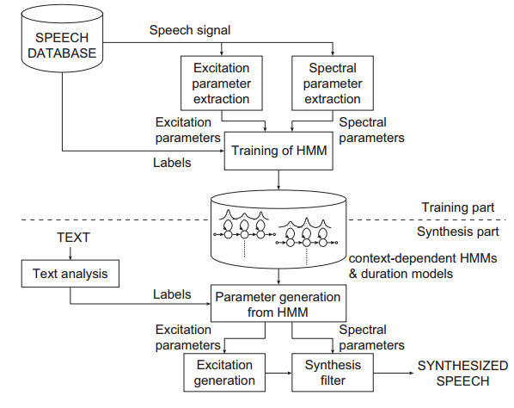
HTS system overview
(Tokuda, Zen, & Black. 2009)

Slide 77
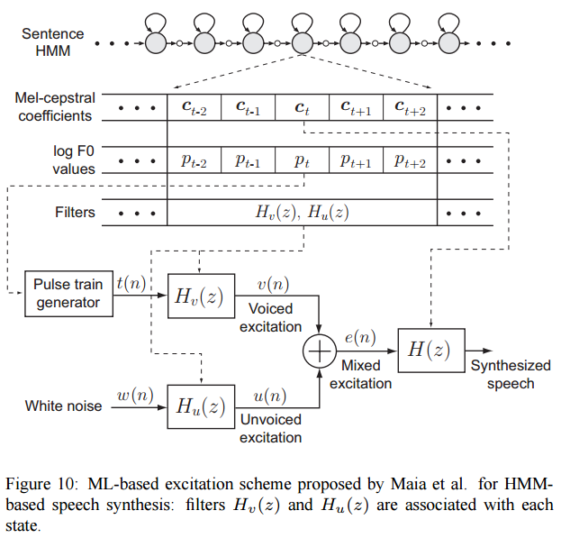
What does the HMM produce?
(Tokuda, Zen, & Black. 2009)

Slide 78
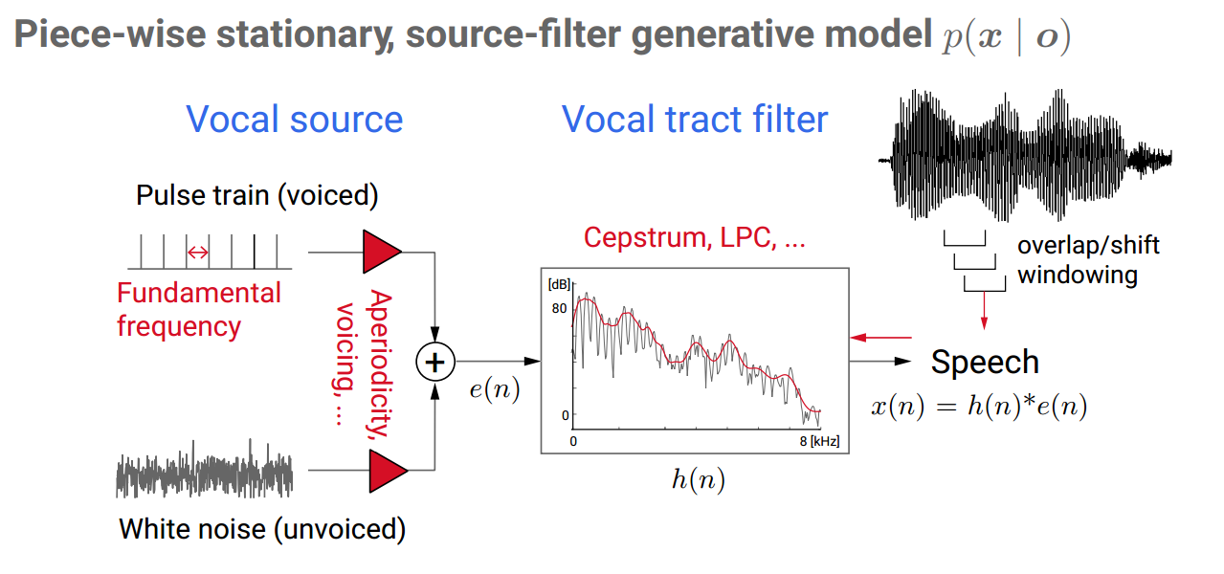
Synthesis with source-filter model
Slide from Heiga Zen

Slide 79
Key Questions in Parametric Synthesis
What parameters do we predict? Usually MFCCs for spectrum, log F0, voicing/excitation
How do we combine them? Exact parameterization and combining them well reduces robotic buzzy effects
How do we make predictions? Choice of HMM, machine learning approaches. Less important than the vocoding/combination issues

Slide 80

HTS Example
Listen to the “low level” buzzy quality characteristic of most parametric systems
Listen to clarity/impact of plosives compared to concatenative example
Notes:
http://www.cstr.ed.ac.uk/projects/festival/morevoices.html

Slide 81
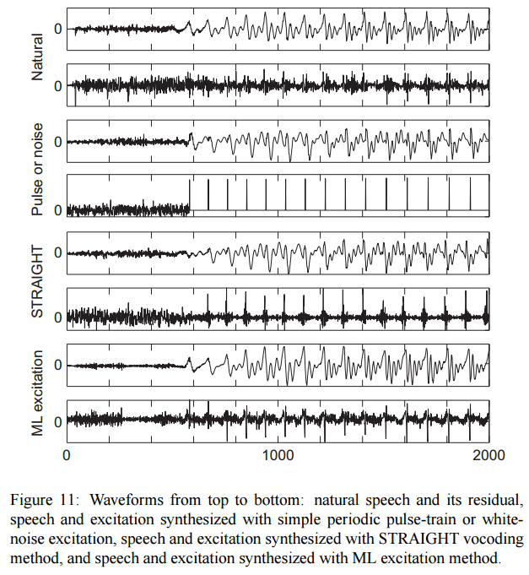
Comparing vocoder/excitation models
(Tokuda, Zen, & Black. 2009)

Slide 82
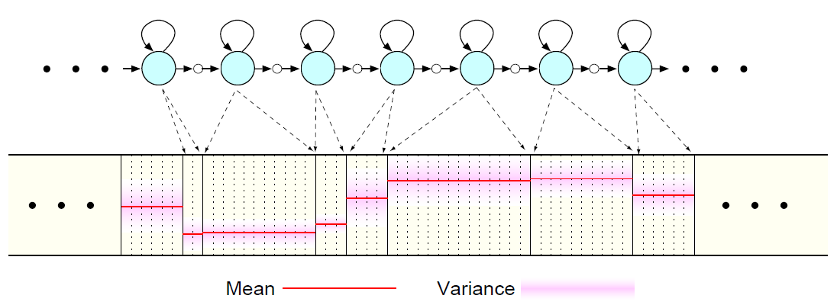
Generating the mean of each state:
Tokuda et al 2009

Slide 83
Observations generated from HMM
Tokuda et al 2009

Slide 84
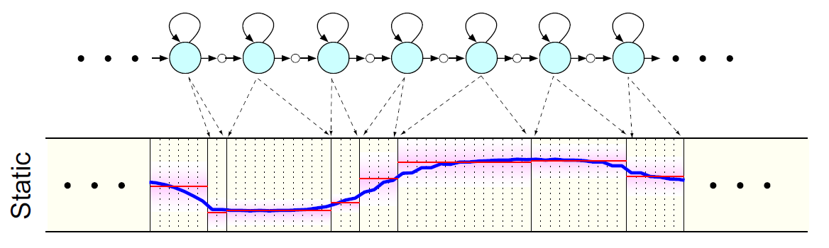
Choosing a sequence of means constrained by deltas and double-deltas
Tokuda and Zen 2009

